Slide 1

UNIT III
SYNCHRONIZATION IN DISTRIBUTED SYSTEMS
Clock synchronization -Physical Clocks, Logical Clocks.
Clock Synchronization Algorithms. Scalor time, Vector time.
Logical clocks - Lamport's Logical Clocks, Vector Clocks. Physical
clock Synchronization- NTP.

Slide 2
In a centralized system, time is unambiguous. When a process wants to know the time, it makes a system call and the kernel tells it.
If process A asks for the time. and then a little later process B asks for the time, the value that B gets will be higher than (or possibly equal to) the value A got. It will certainly not be lower.
In a distributed system, achieving agreement on time is not trivial.

Slide 3
In distributed computing, where multiple systems collaborate to accomplish tasks ensuring that all the clocks are synchronized plays a crucial role.
Clock synchronization involves aligning the clocks of computers or nodes, enabling efficient data transfer, smooth communication, and coordinated task execution.
What is Clock Synchronization in Distributed Systems?
Clock synchronization in distributed systems refers to the process of ensuring that all clocks across various nodes or computers in the system are set to the same time or at least have their times closely aligned.
In a distributed system, where multiple computers communicate and collaborate over a network, each computer typically has its own local clock.

Slide 4
However, due to factors such as hardware differences, network delays, and clock drift (inaccuracies in timekeeping), these local clocks can drift apart over time.
Importance of Clock Synchronization
Below are the importance of clock synchronization in distributed system:
Consistency and Coherence:
  Clock synchronization ensures that timestamps and time-based decisions made across different nodes in the distributed system are consistent and coherent. This is crucial for maintaining the correctness of distributed algorithms and protocols.

Slide 5
Event Ordering:
  Many distributed systems rely on the notion of event ordering based on timestamps to ensure causality and maintain logical consistency. Clock synchronization helps in correctly ordering events across distributed nodes.
Data Integrity and Conflict Resolution:
  In distributed databases and file systems, synchronized clocks help in timestamping data operations accurately. This aids in conflict resolution and maintaining data integrity, especially in scenarios involving concurrent writes or updates.

Slide 6
Fault Detection and Recovery:
  Synchronized clocks facilitate efficient fault detection and recovery mechanisms in distributed systems. Timestamps can help identify the sequence of events leading to a fault, aiding in debugging and recovery processes.
Security and Authentication:
  Timestamps generated by synchronized clocks are crucial for security protocols, such as in cryptographic operations and digital signatures. They provide a reliable basis for verifying the authenticity and temporal validity of transactions and messages.

Slide 7
Physical Clocks
Nearly all computers have a circuit for keeping track of time. Despite the widespread use of the word "clock" to refer to these devices, they are not actually clocks in the usual sense. Timer is perhaps a better word.
A computer timer is usually a precisely machined quartz crystal. When kept under tension, quartz crystals oscillate at a well-defined frequency that depends on the kind of crystal, how it is cut, and the amount of tension.
Associated with each crystal are two registers, a counter and a holding register. Each oscillation of the crystal decrements the counter by one. When the counter gets to zero, an interrupt is generated and the counter is reloaded from the holding register. In this way, it is possible to program a timer to generate an interrupt 60 times a second, or at any other desired frequency. Each interrupt is called one clock tick.

Slide 8
With a single computer and a single clock, it does not matter much if this clock is off by a small amount. Since all processes on the machine use the same. clock, they will still be internally consistent. For example, if the file input.c has time 2151 and file input.o has time 2150, make will recompile the source file, even if the clock is off by 2 and the true times are 2153 and 2152, respectively. All that really matters are the relative times.
As soon as multiple CPUs are introduced, each with its own clock, the situation changes radically. Although the frequency at which a crystal oscillator runs is usually fairly stable, it is impossible to guarantee that the crystals in different computers all run at exactly the same frequency.

Slide 9
In practice, when a system has n computers, all n crystals will run at slightly different rates, causing the (software) clocks gradually to get out of synch and give different values when read out. This difference in time values is called clock skew.
In some systems (e.g., real-time systems), the actual clock time is important. Under these circumstances, external physical clocks are needed. For reasons of efficiency and redundancy, multiple physical clocks are generally considered desirable, which yields two problems: (1) How do we synchronize them with realworld clocks. and (2) How do we synchronize the clocks with each other?

Slide 10
CLOCK SYNCHRONIZATION ALGORITHMS
Centralized
Passive and active time server
Distributed
Global averaging distributed algorithm
Local averaging distributed algorithm

Slide 11
CLOCK SYNCHRONIZATION ALGORITHMS
Passive time server centralized algorithm
Each node sends message to time server
Time server replies time = T
Time ? …..To
Time=T…..T1
Propagation time : (T1 – T0)/2
Client side clock = T + ( T1- T0)/2

Slide 12
CLOCK SYNCHRONIZATION ALGORITHMS
Active time server centralized algorithm
Time server broadcasts time to other nodes
Time = T
The other nodes adjust their time accordingly
Each node has a priori broadcast time knowledge Ta[approx]
For propagation “time = T”
Time is T + Ta
Delays in broadcasts are major

Slide 13
The Berkeley Algorithm
Here thevtime server (actually, a time daemon) is active, polling every machine from time to time to ask what time it is there. Based on the answers, it computes an average time and tells all the other machines to advance their clocks to the new time or slow their clocks down until some specified reduction has been achieved.
The time daemon's time must be set manually by the operator periodically.

Slide 14
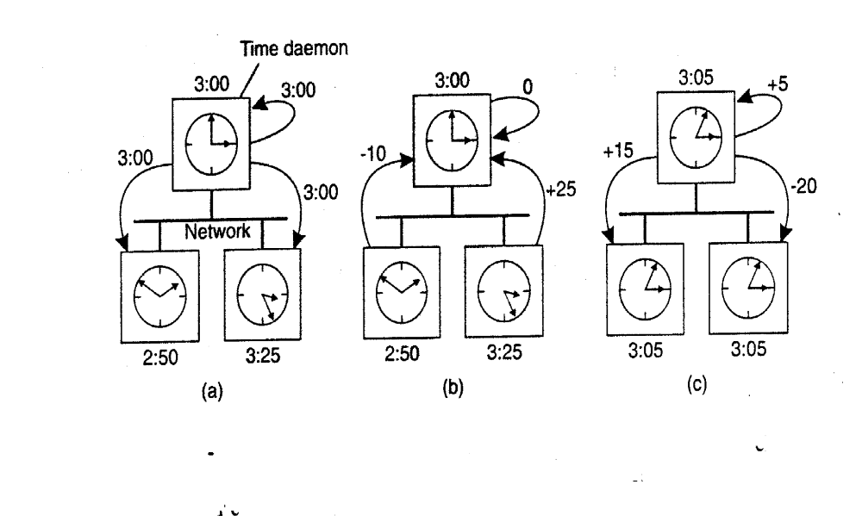

Slide 15
EVENT ORDERING
Happened Before Relation (denoted by --> )
If a and b are events in same process, and a occurs before b then a->b
If a is an event of sending a message by one process and b is the event of receipt of same message by another process,then a->b…receiver cannot receive unless sender sends it.Time taken for the message propogation from receiver to sender is always positive.
If a -> b and b -> c,then a -> c,thus happened before is a transitive relation.

Slide 16
LOGICAL CLOCKS CONCEPT
The concept of a logical clock is a way to associate a timestamp (which maybe a simple number independent of any clock time)
Eg : Pi has a clock Ci associated with it that assigns a number Ci(a) to any event a in that process.

Slide 17
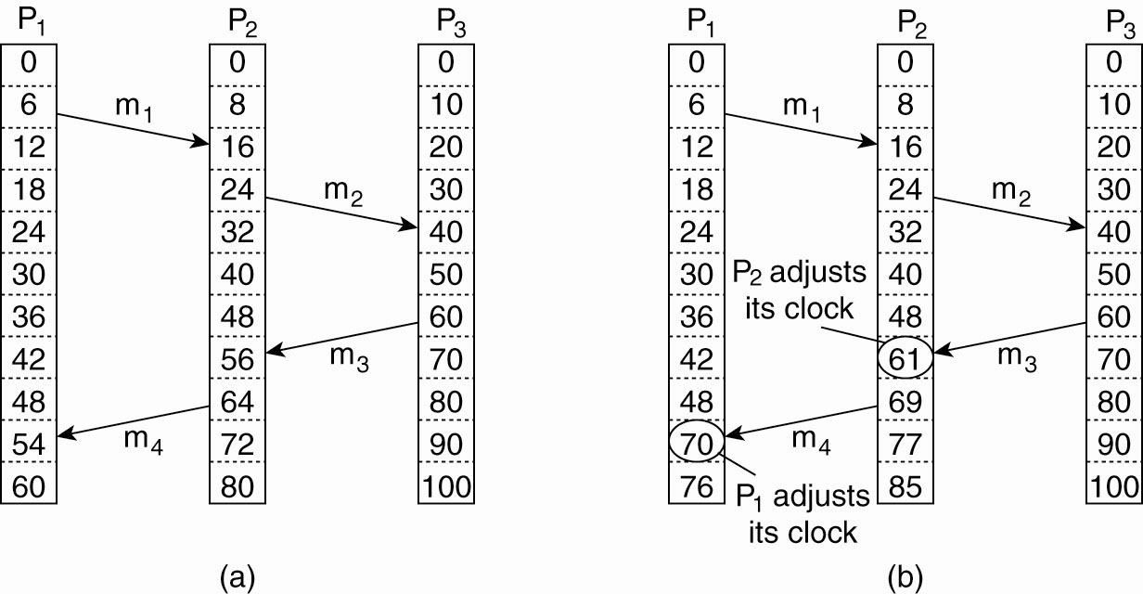
LAMPORT’S LOGICAL CLOCKS (2)
Figure 6-9. (a) Three processes, each with its own clock.
The clocks run at different rates.

Slide 18
LAMPORT’S LOGICAL CLOCKS (3)
Figure 6-9. (b) Lamport’s algorithm corrects the clocks.

Slide 19
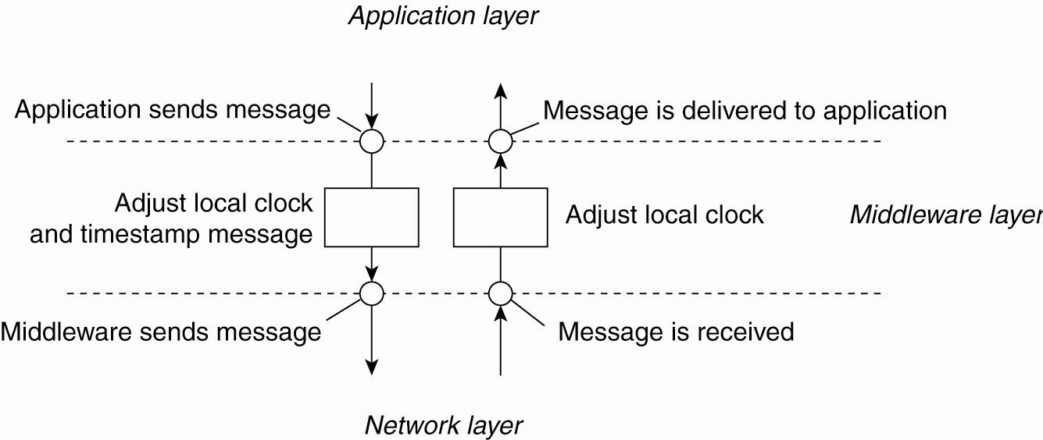
LAMPORT’S LOGICAL CLOCKS (4)
Figure 6-10. The positioning of Lamport’s logical
clocks in distributed systems.

Slide 20
IMPLEMENTATION OF LOGICAL CLOCKS
C1 : If a and b are two events within the same process Pi and a occurs before b,then Ci(a) <Ci(b)
C2 : If a is the sending of a message by process Pi and b is the receipt of that message by process Pj , then Ci(a) < Cj(b)
C3 : A clock Ci associated with a process Pi must always go forward,never backward.Correctness is made by adding value never subtracting it

Slide 21
IMPLEMENTATION OF LOGICAL CLOCKS
IR1 :Each process Pi increments Ci between any two successive events
IR2 :If event a is the sending of a message m by process Pi, the message m contains a timestamp Tm = Ci (a) and upon receiving the message m a process Pj sets Cj greater than or equal to its present value but greater than Tm.

Slide 22
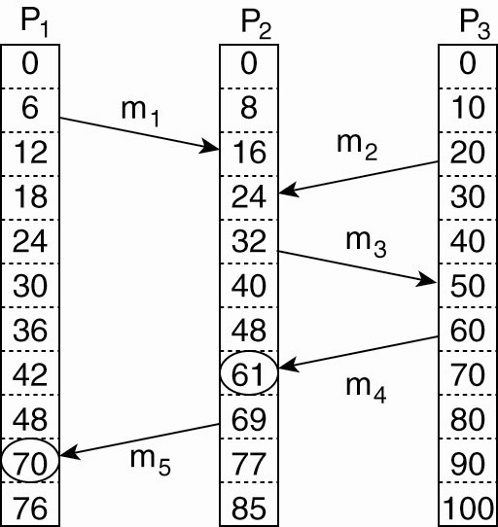
VECTOR CLOCKS (1)
Figure 6-12. Concurrent message transmission
using logical clocks.

Slide 23
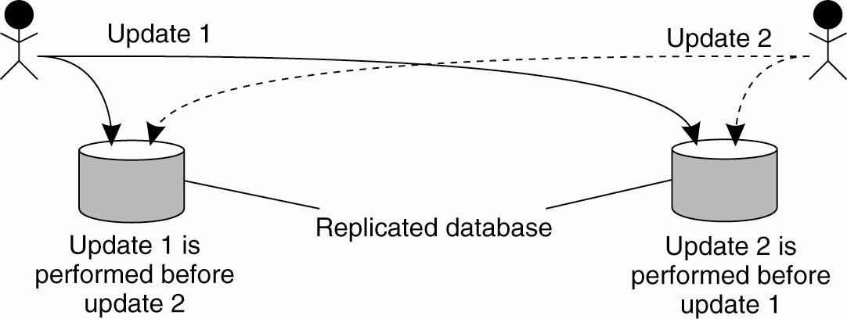
EXAMPLE: TOTALLY ORDERED MULTICASTING
Figure 6-11. Updating a replicated database and
leaving it in an inconsistent state.

Slide 24
IMPLEMENTATION OF LOGICAL CLOCKS
Logical clocks can be implemented using :-
Counters
Physical clocks

Slide 25
Logical Clocks
In a distributed system, multiple machines are working together, and each machine may have its own clock. still, these clocks may not be accompanied with each other, and there's no single clock that can be used to order events globally.
Logical clocks give a way to handle this by assigning each event a logical timestamp, which can be used to order events and establish reason between them, indeed if they do on different machines.
In substance, logical clocks give a way to produce a virtual global timepiece that's consistent across all machines in a distributed system.

Slide 26
SCALAR TIME IMPLEMENTATION
There are different methods for implementing logical clocks in a distributed system, but one of the simplest is Scalar Time.
In this implementation, each process keeps a local clock that is initially set to 0. There are two rules for updating the local clock −
Rule 1: Event Execution
Before executing an event (excluding the event of receiving a message), increment the local clock by 1
Rule 2: Message Reception
When receiving a message (the message must include the sender's local clock value), set your local clock to the maximum of the received clock value and the local clock value. After this, increment your local clock by 1.

Slide 27
Rule 1: Event Execution
local_clock = local_clock + 1
Rule 2: Message Reception
local_clock = max(local_clock, received_clock) local_clock = local_clock + 1

Slide 28
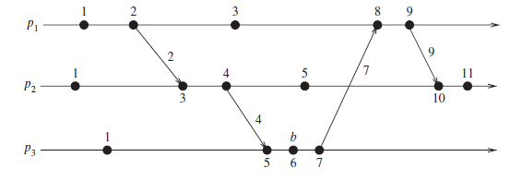

Slide 29
Vector Clock
is an algorithm that generates partial ordering of events and detects causality violations in a distributed system. These clocks expand on Scalar time to facilitate a causally consistent view of the distributed system, they detect whether a contributed event has caused another event in the distributed system. It essentially captures all the causal relationships.
This algorithm helps us label every process with a vector(a list of integers) with an integer for each local clock of every process within the system.
So for N given processes, there will be vector/ array of size N.

Slide 30
How does the vector clock algorithm work?
Initially, all the clocks are set to zero.
Every time, an Internal event occurs in a process, the value of the processes’s logical clock in the vector is incremented by 1
Also, every time a process sends a message, the value of the processes’s logical clock in the vector is incremented by 1.
Every time, a process receives a message, the value of the processes’s logical clock in the vector is incremented by 1
Moreover, each element is updated by taking the maximum of the value in its own vector clock and the value in the vector in the received message (for every element).

Slide 31
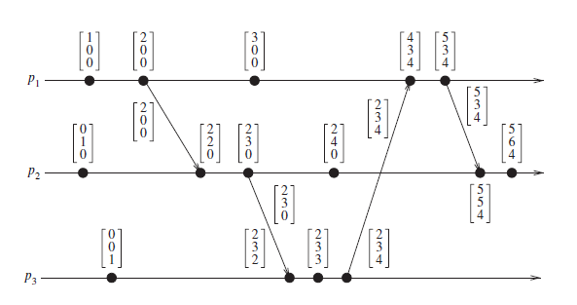

Slide 32
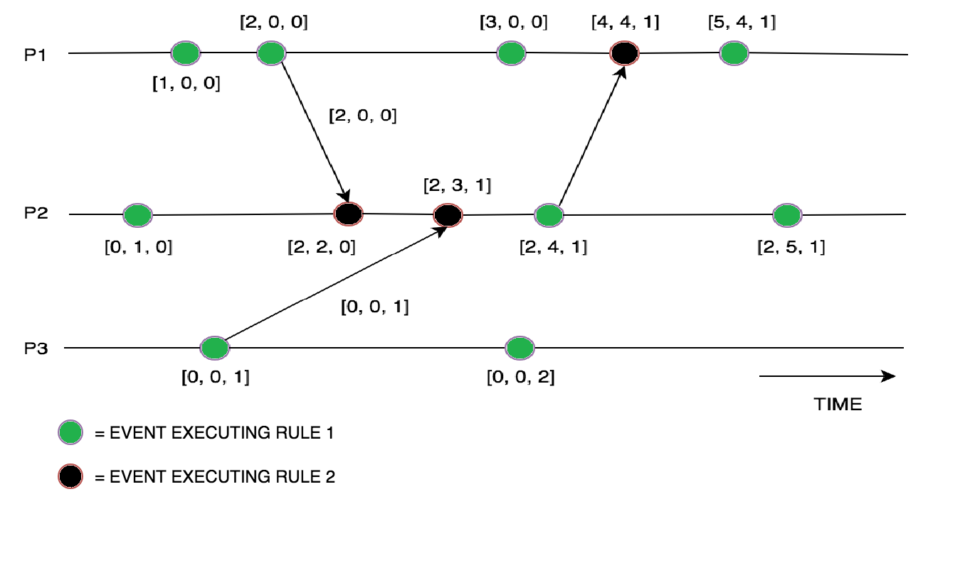


Slide 33
MUTUAL EXCLUSION
Fundamental to distributed systems is the concurrency and collaboration among multiple processes. In many cases, this also means that processes will need to simultaneously access the same resources.
To prevent that such concurrent accesses corrupt the resource, or make it inconsistent, solutions are needed to grant mutual exclusive access by processes.
Distributed mutual exclusion algorithms can be classified into two different categories. In token-based solutions mutual exclusion is achieved by passing a special message between the processes, known as a token.
There is only one token available and who ever has that token is allowed to access the shared resource.

Slide 34
When finished, the token is passed on to a next process.
If a process having the token is not interested in accessing the resource, it simply passes it on.
A Centralized Algorithm
The most straightforward way to achieve mutual. exclusion in a distributed system is to simulate how it is done in a one-processor system.
One process is elected as the coordinator. Whenever a process wants to access a shared resource, it sends a request message to the coordinator stating which resource it wants to access and asking for permission.
If no other process is currently accessing that resource, the coordinator sends back a reply granting permission.

Slide 35
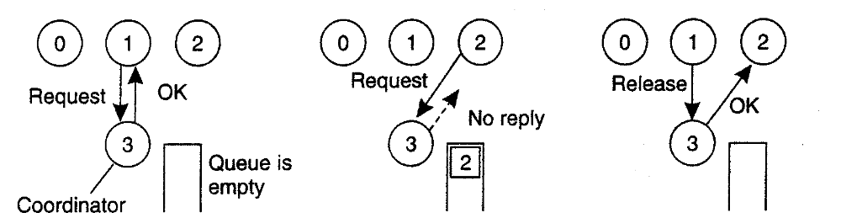
(a) Process 1 asks the coordinator for permission to access a
shared resource. Permission is granted.
(b) Process 2 then asks permission to access the same resource. The coordinator does not reply.
(c) When process 1 releases the resource, it tells the coordinator, which then replies to 2.

Slide 36
It is easy to see that the algorithm guarantees mutual exclusion: the coordinator
only lets one process at a time to the resource. It is also fair, since requests are granted in the order in which they are received. No process ever waits forever (no starvation). The scheme is easy to implement, too, and requires only three messages per use of resource (request, grant, release).
The centralized approach also has shortcomings.
The coordinator is a single point of failure, so if it crashes, the entire system may go down.
If processes normally block after making a request, they cannot distinguish a dead coordinator from "permission denied" since in both cases no message comes back.

Slide 37
A Distributed Algorithm
The algorithm works as follows. When a process wants to access a shared resource, it builds a message containing the name of the resource, its process number, and the current (logical) time.
It then sends the message to all other processes, conceptually including itself. The sending of messages is assumed to be reliable; that is, no message is lost.
When a process receives a request message from another process, the action it takes depends on its own state with respect to the resource named in the message.

Slide 38
Three different cases have to be clearly distinguished:
1. If the receiver is not accessing the resource and does not want to access it, it sends back an OK message to the sender.
2. If the receiver already has access to the resource, it simply does not reply. Instead, it queues the request.
3. If the receiver wants to access the resource as well but has not yet done so, it compares the timestamp of the incoming message with me. one contained in the message that it has sent everyone. The lowest one wins.
If the incoming message has a lower timestamp, the receiver sends back an OK message. If its own message has a lower timestamp, the receiver queues the incoming request and sends nothing.

Slide 39
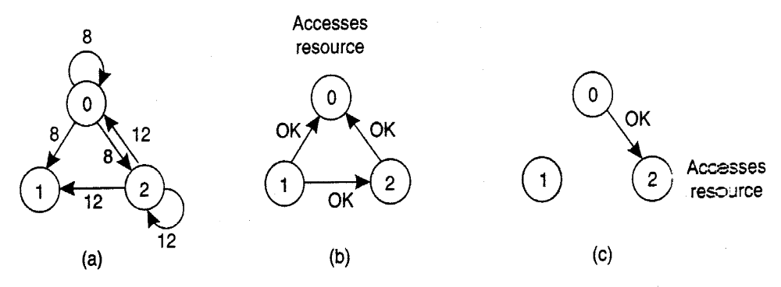
After sending out requests asking permission, a process sits back and waits until everyone else has given permission. As soon as all the permissions are in, it may go ahead.
When it is finished, it sends OK messages to all processes on its queue and deletes them all from the queue.

Slide 40
(a) Two processes want to access a shared resource at the same moment.
(b) Process 0 has the lowest timestamp. so it wins.
(c) When process 0 is done, it sends an OK also, so 2 can now go ahead. Process 0 sends everyone a request with timestamp.

Slide 41
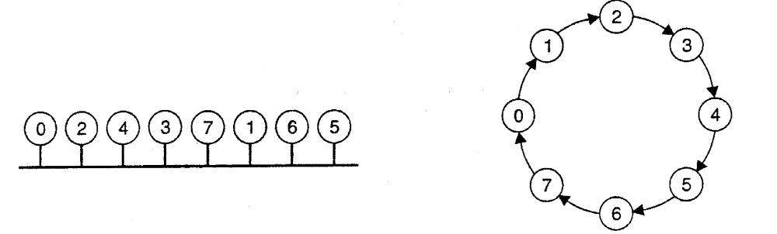
A TOKEN RING ALGORITHM
Here we have a bus network, as shown in Fig. 6-16(a), (e.g., Ethernet), with no inherent ordering of the processes. In software, a logical ring is constructed in which each process is assigned a position in the ring, as shown in Fig. 6-16(b).
The ring positions may be allocated in numerical order of network addresses or some other means. It does not matter what the ordering is. All that matters is that each process knows who is next in line after itself.

Slide 42
As usual, this algorithm has problems too. If the token is ever lost, it must be regenerated. In fact, detecting that it is lost is difficult, since the amount of time between successive appearances of the token on the network is unbounded. The fact that the token has not been spotted for an hour does not mean that it has been lost; somebody may still be using it.

Slide 43
ELECTION ALGORITHMS
Many distributed algorithms require one process to act as coordinator, initiator, or otherwise perform some special role. In general, it does not matter which process takes on this special responsibility, but one of them has to do it. In this section we will look at algorithms for electing a coordinator.
In general, election algorithms attempt to locate the process with the highest process number and designate it a coordinator.

Slide 44
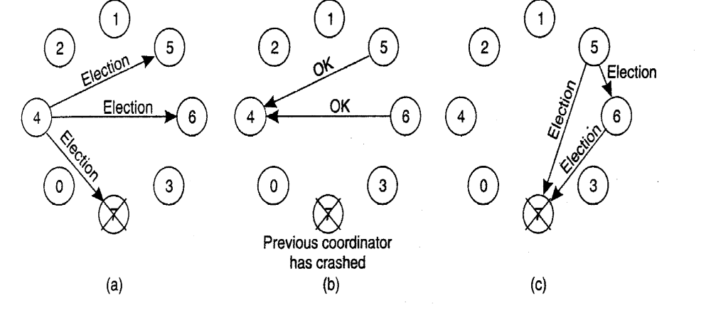
THE BULLY ALGORITHM
When any process notices that the coordinator is no longer responding to requests, it initiates an election. A process,
1. P sends an ELECTION message to all processes with higher numbers.
2. If no one responds, P wins the election and becomes coordinator.
3. If one of the higher-ups answers, it takes over. P's job is done. P, holds an election as follows:

Slide 45
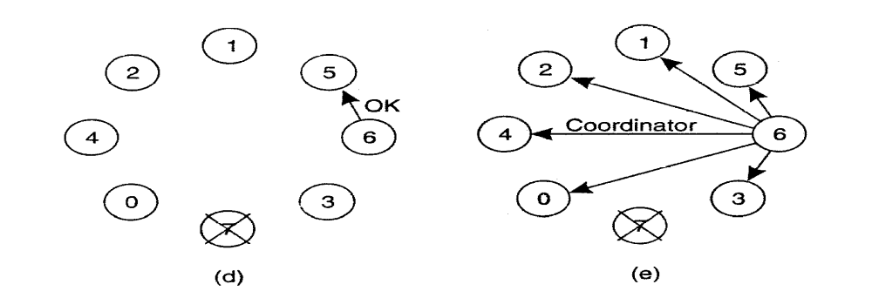
A Ring Algorithm

Slide 46
Exercise 2
Explain "call by reference" vs. "call by value".
How does so called marshalling solve the problem of different byte ordering of sender and receiver?

